Slide 1

The Aga Khan Hospital Dar es Salaam
Obstetrics & Gynaecology - OPA Documentation Compliance for Q4 2022

Slide 2
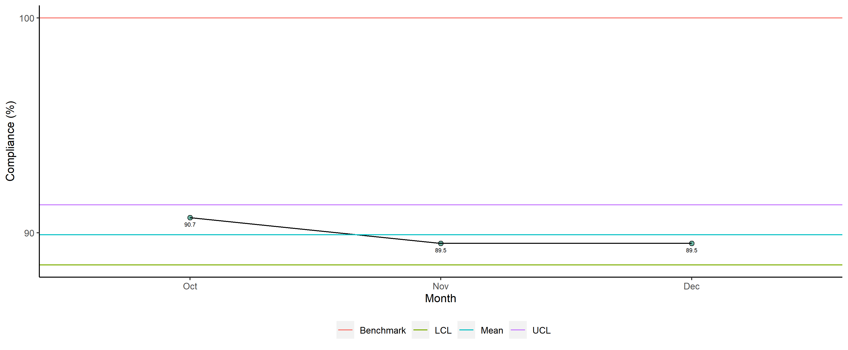
Obstetrics & Gynaecology - Availability of Required Documents

Slide 3
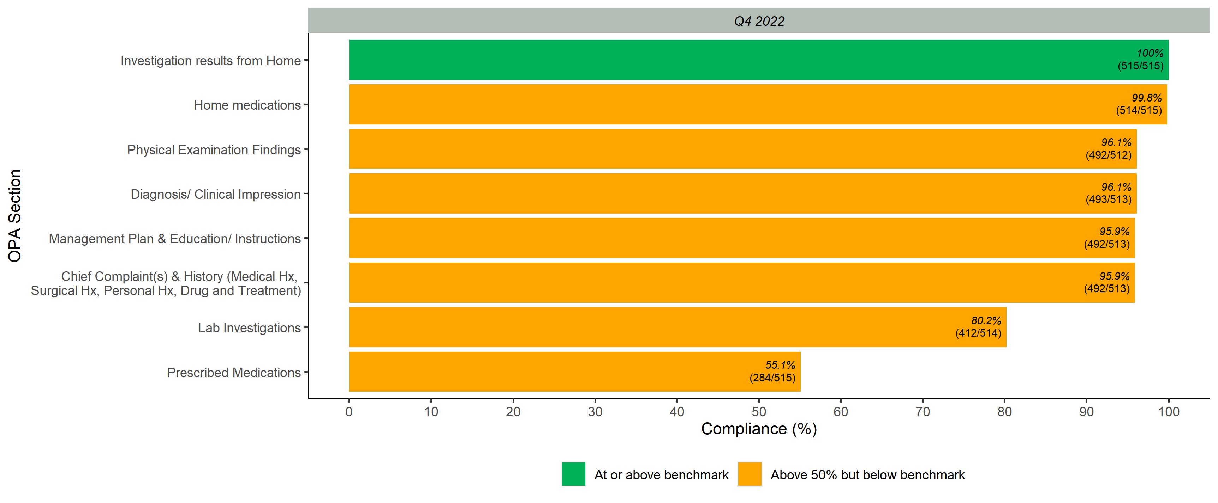
Documented Scores per OPA Section

Slide 4
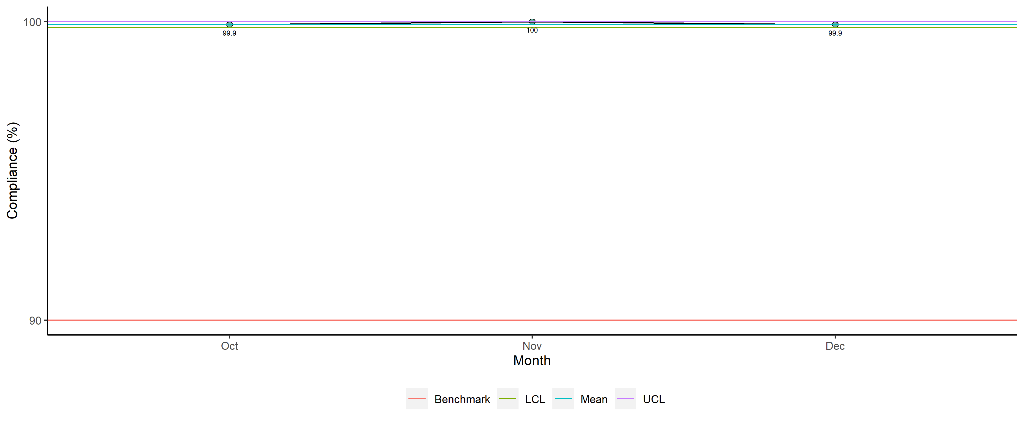
Obstetrics & Gynaecology - Legibility

Slide 5
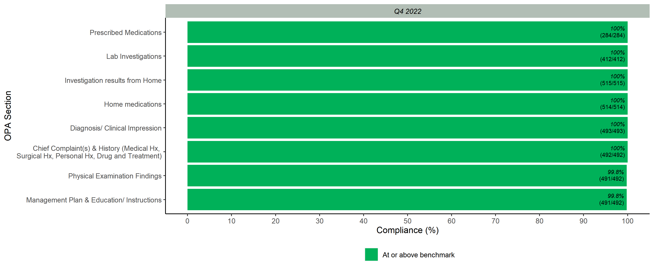
Legibility Scores per OPA Section

Slide 6
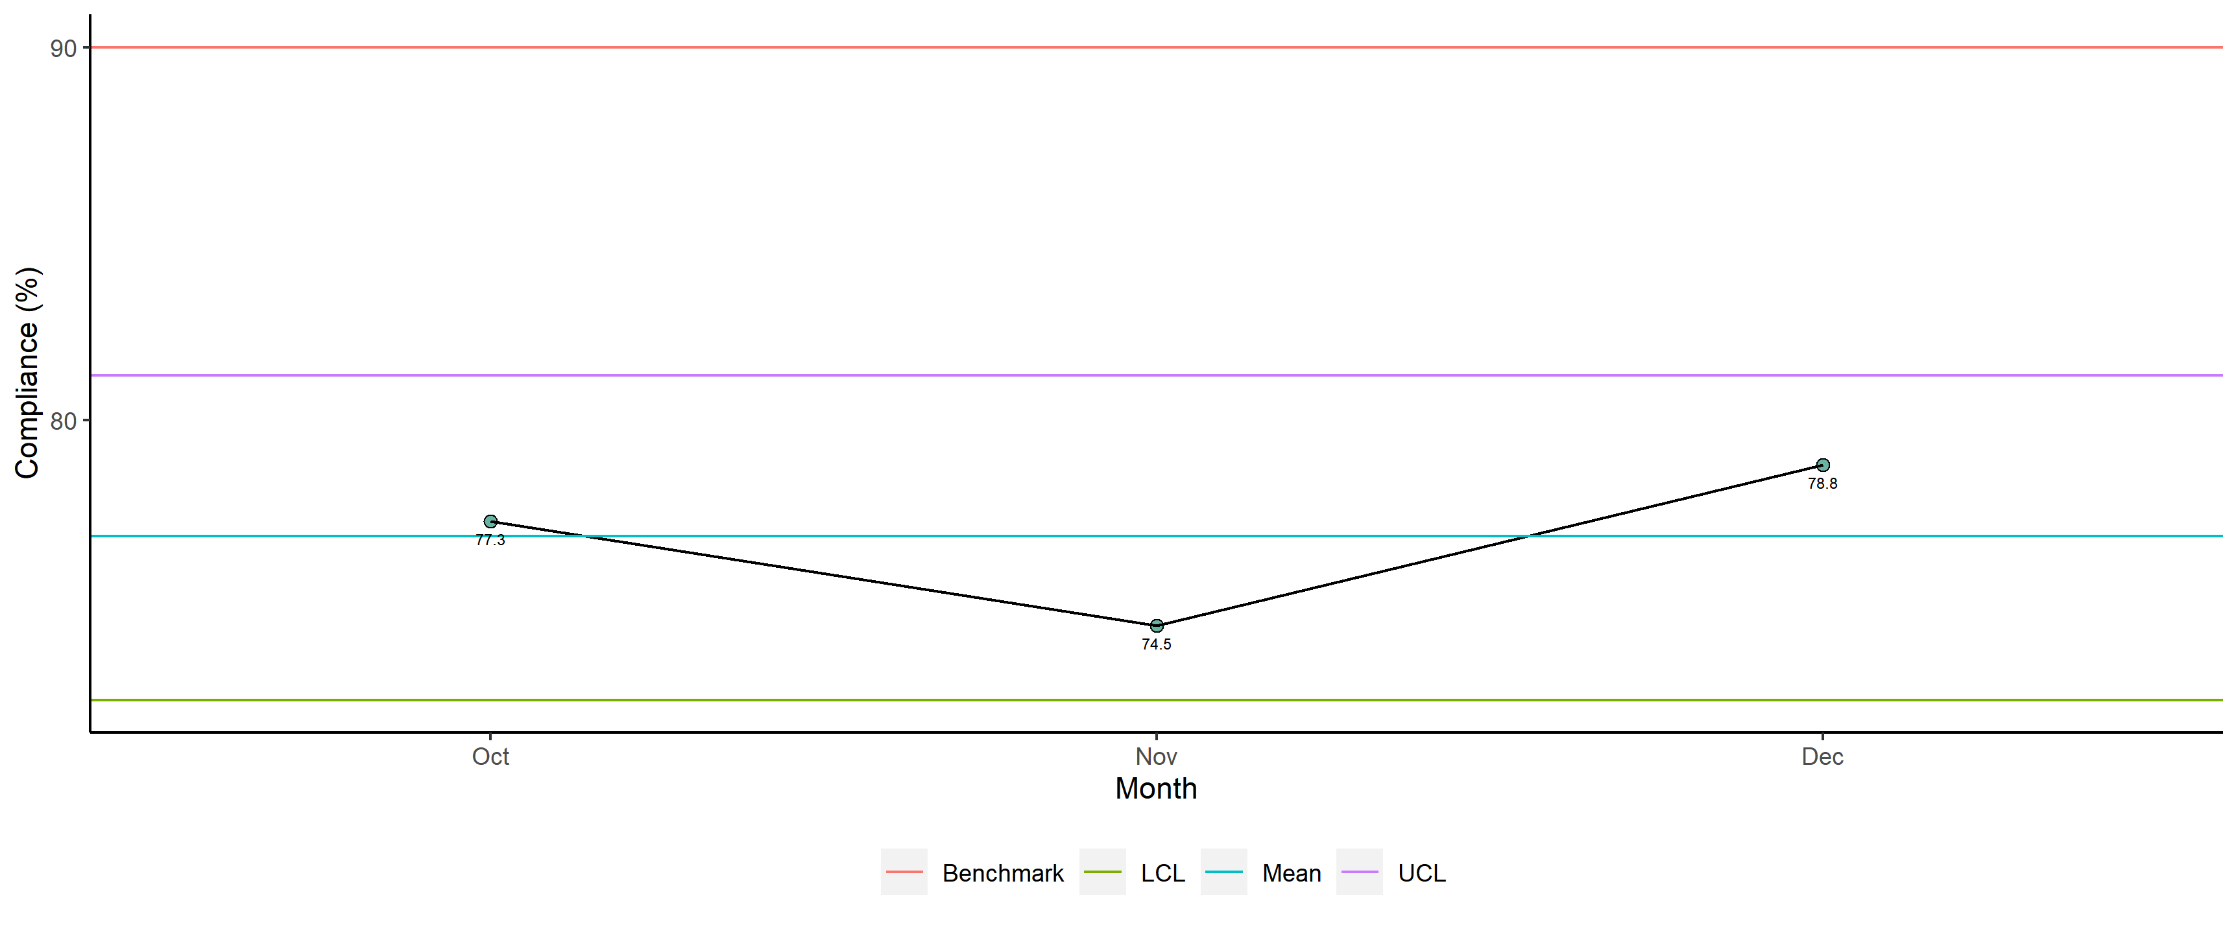
Obstetrics & Gynaecology - Completeness

Slide 7
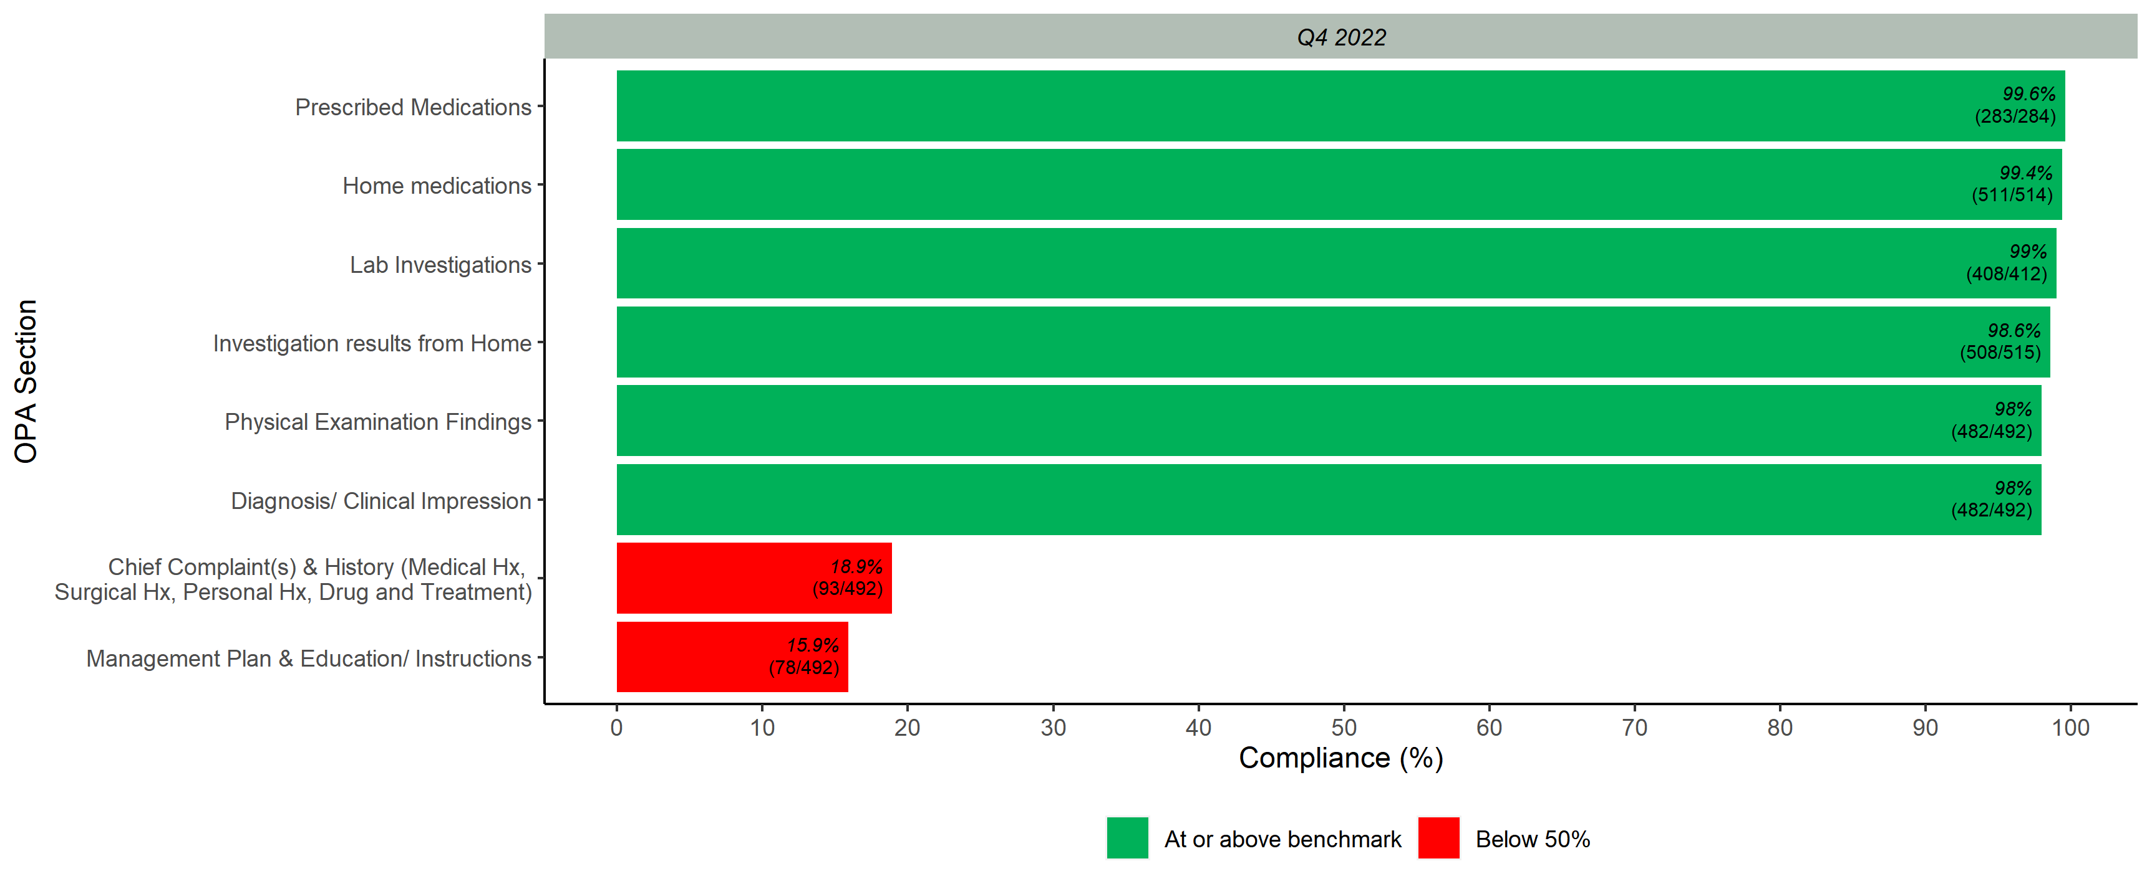
Completeness Scores per OPA Section

Slide 8
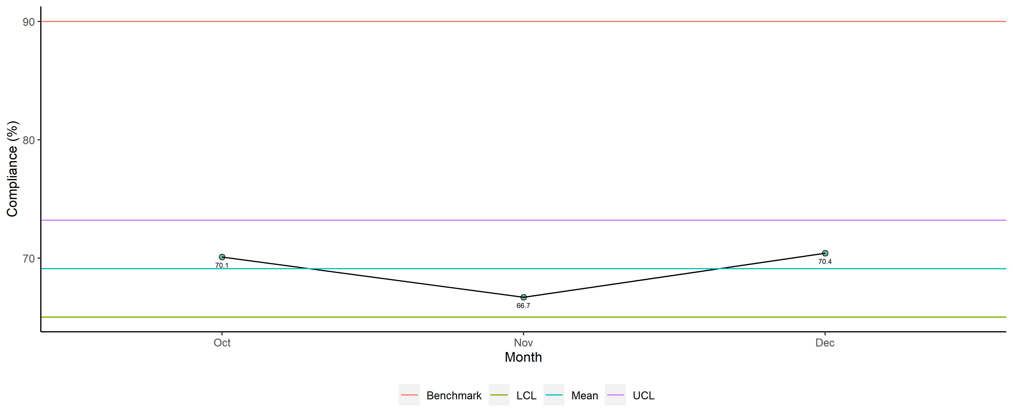
Obstetrics & Gynaecology - Overall

Slide 9
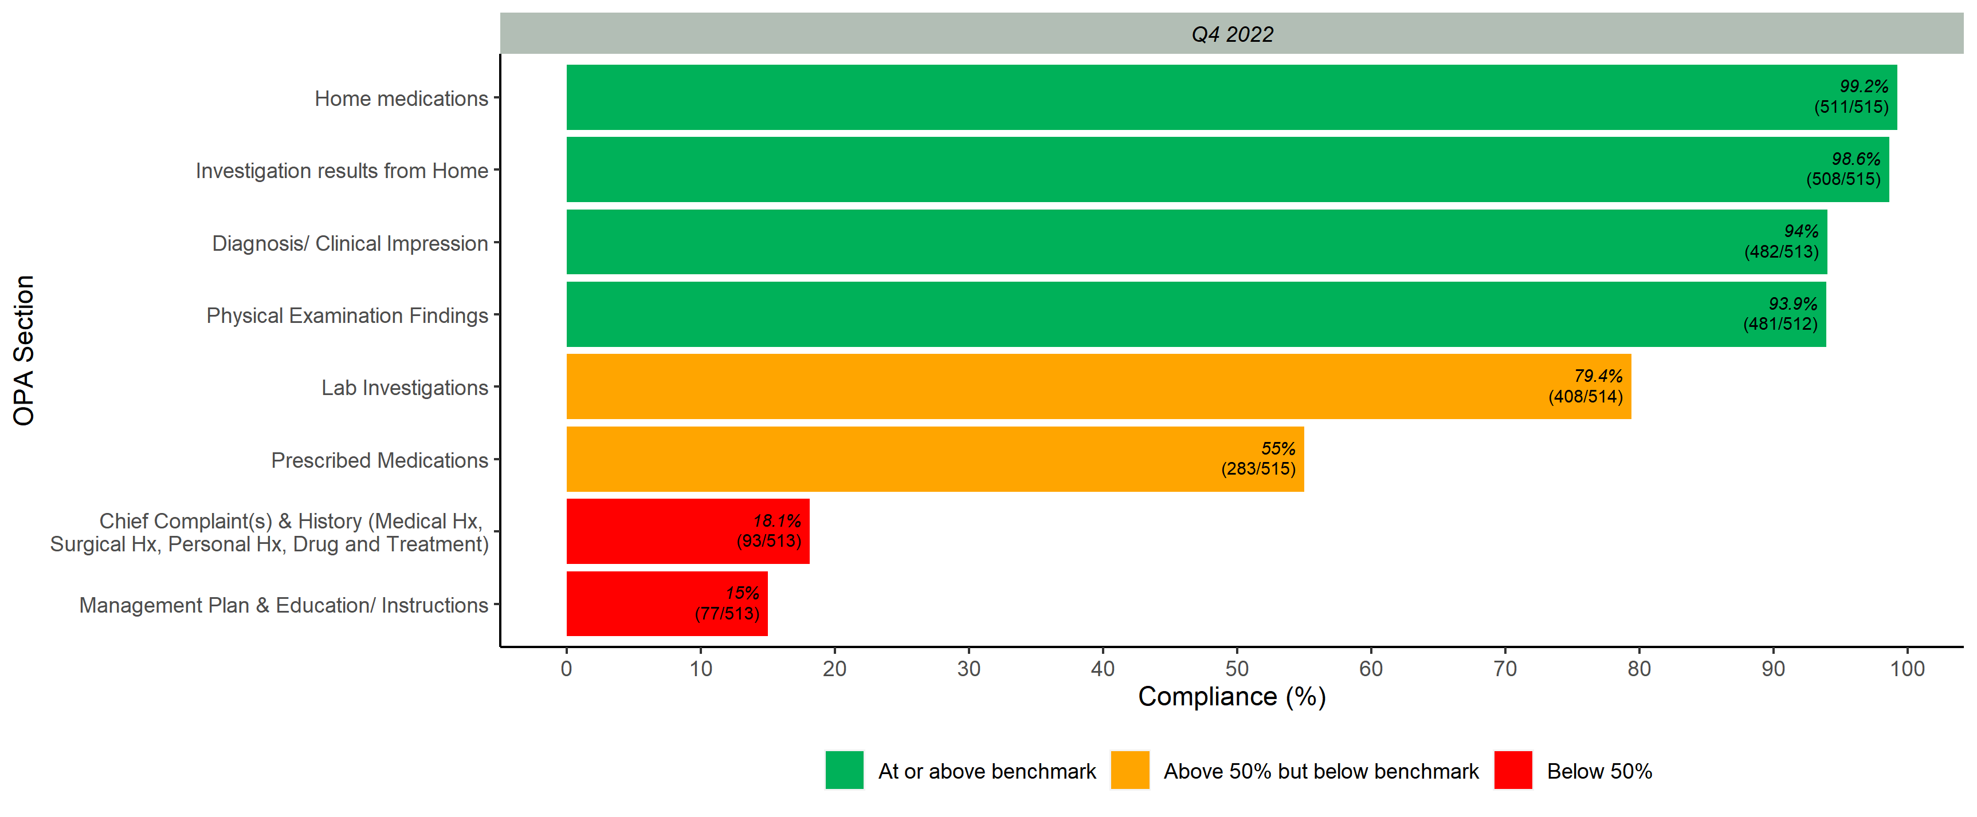
Overall Scores per OPA Section

